Slide 1


DATA BASE MANGEMENT SYSTEM

Slide 2


BLOG CREATOR WEB APPLICATION
BY
E.SRI HARSHA - (2110030214)
P.AKSHARA - (2110030225)
P.MEGHANA - (2110030230)
G.SHASHANK- (2110030322)
UNDER THE GUIDANCE OF
(P.SREE LAKSHMI)

Slide 3
PROBLEM STATEMENT AND DOMAIN
We have come here with “ Blog Creator Web Application :- Creating an web application to facilitate the blog creation capabilities.”.
Not having a clear topic and niche for the blog.
They’re not producing engaging ,outstanding quality content.
It takes a lot of hard work and plenty of time.
Changes on the website are not displaying.
Not setting up your web hosting and site correctly.

Slide 4
EXISITING SOLUTIONS
Blogging enables you to reach the billions of people that use the Internet.
Here the users will consume less amount of time when compared to manual paper work through the automated system.
Having a blog and writing about important topics that are relevant to your audience establishes yourself as an authority in the space.
Web Blog Development system is an objective which is developing according to the people’s view and thoughts.

Slide 5
PROPOSED ALGORITHM DESIGN TECHNIQUE
Initially, user comes up with a simple layout. However, in due course, user stumbles upon some great design blogs like Smashing Magazine and Web Designer Depot and is inspired to see all those beautifully designed blogs.
User redesigns his blog only to find out that now his blog looks too similar to some of those which user saw earlier.
To avoid the similarity, user adds a number of different elements and unnecessarily features to his blog which makes it overly complicated to use.
Finally, after all these iterations, user decides to have a minimalist but beautiful design for his blog.

Slide 6
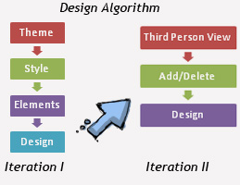
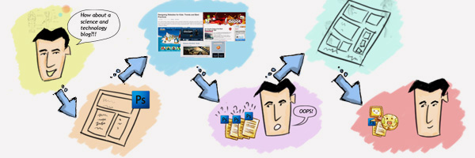

Slide 7
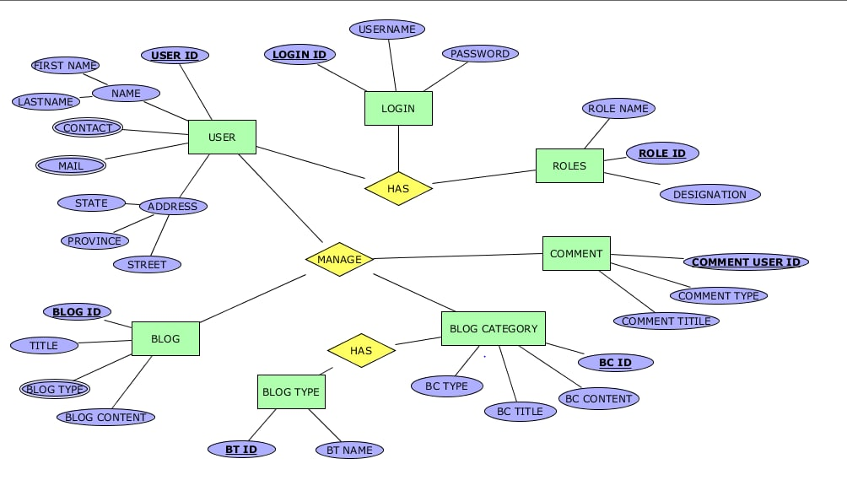
ER DIAGRAM

Slide 8
TOOLS REQUIRED
TERRA ER:-Terra ER is a free open-source learning tool designed to aid students in the creation of entity-relationship models. Our main goal is to provide students with a tool that reflects exactly the data modeling concepts learned in the classroom.
MY SQL:- MySQL is a fully managed service that enables customers to run OLTP, OLAP, and machine learning workloads directly from their MySQL Database.

Slide 9
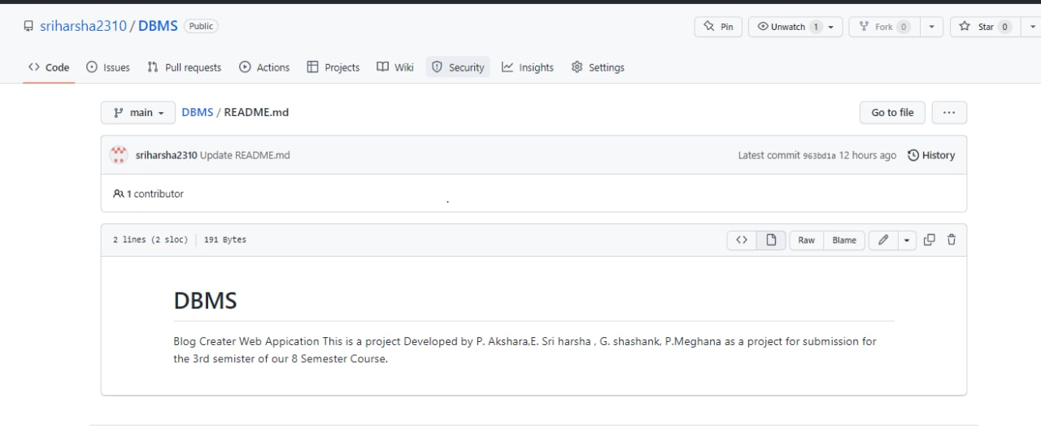
GITHUB SETUP
https://github.com/Akshu2509/DBMS/blob/main/README.md
https://github.com/Megha17na11/DBMS/blob/main/README.md
https://github.com/shashank5821/DBMS/blob/main/README.md

Slide 10

REFERENCES
https://10web.io/blog/10-biggest-issues-bloggers-face-and-how-to-tackle-them/
https://www.researchgate.net/publication/273493095_Issues_and_challenges_of_using_web_blogs_as_a_medium_for_research_communication

Slide 11

DIVISION OF WORK AMONG GROUP MEMBERS
Sri Harsha :-Research and ER diagram.
Akshara :- Existing solutions.
Meghana :- Proposed algorithm design technique.
Shashank :- Searched about the data structure needed.

Slide 12


